Slide 1

Today’s Agenda
Synchronous counters
BCD counter
Binary counters with unused states

Slide 2
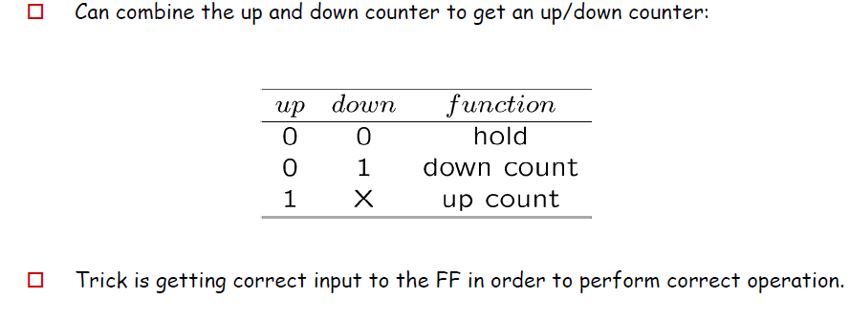
Synchronous Binary Counter-Up/Down Counter

Slide 3
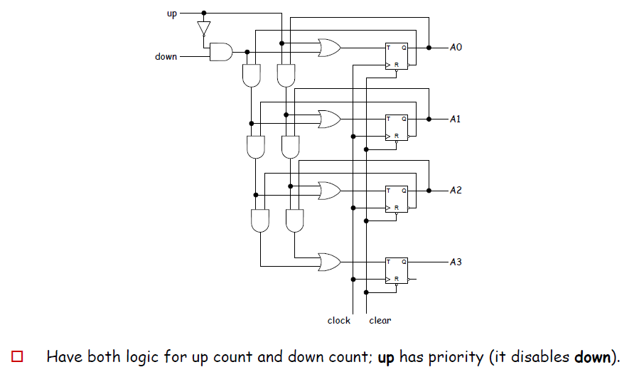
Synchronous Binary Counter-Up/Down Counter

Slide 4
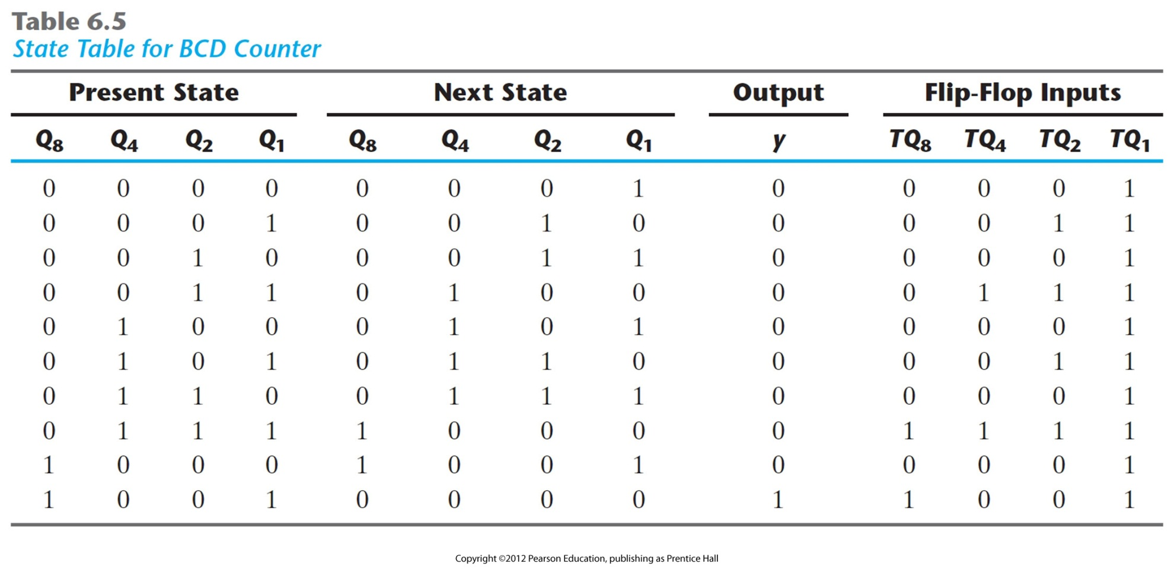
BCD Counter (Using Usual Approach)
State Table

Slide 5
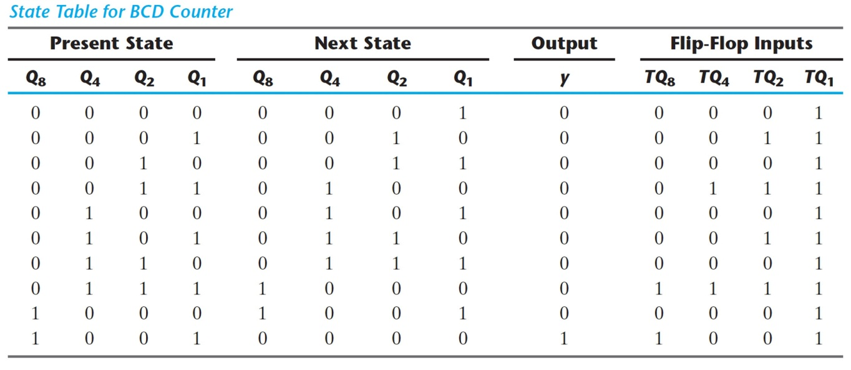
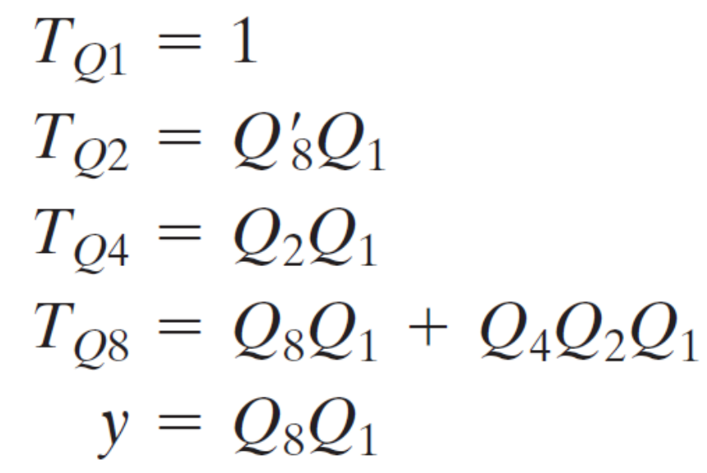
BCD Counter (Using Usual Approach)
Write F/F I/p Equations (Using Excitation Table)

Slide 6
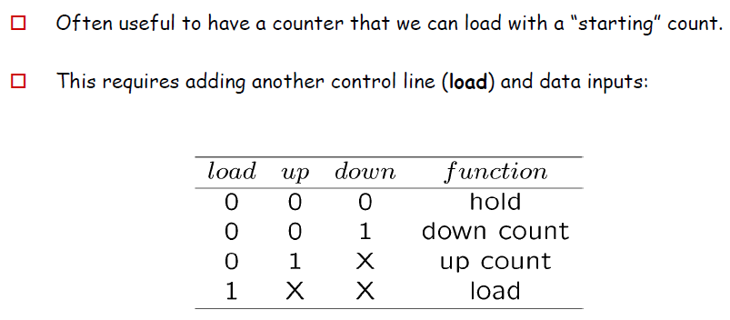
Binary Counter with Parallel Load

Slide 7
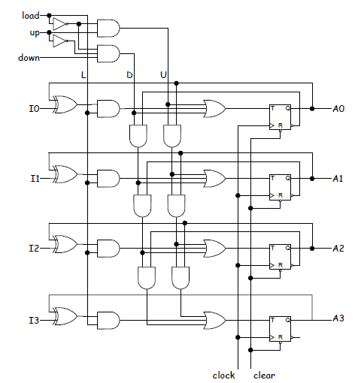
Binary Counter with Parallel Load
Designed with TFF

Slide 8

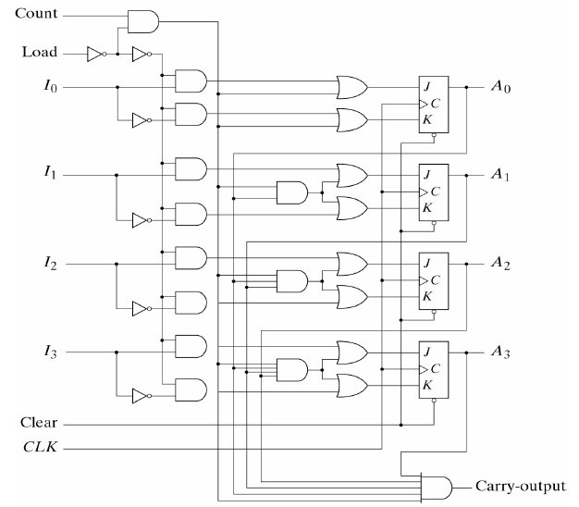
Binary Counter with Parallel Load
Designed with JK FF

Slide 9
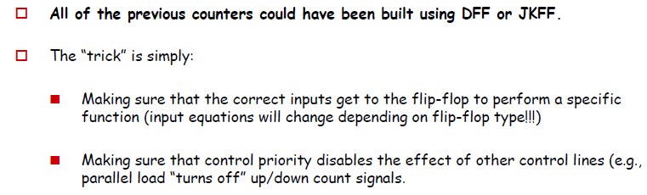
Comments:

Slide 10
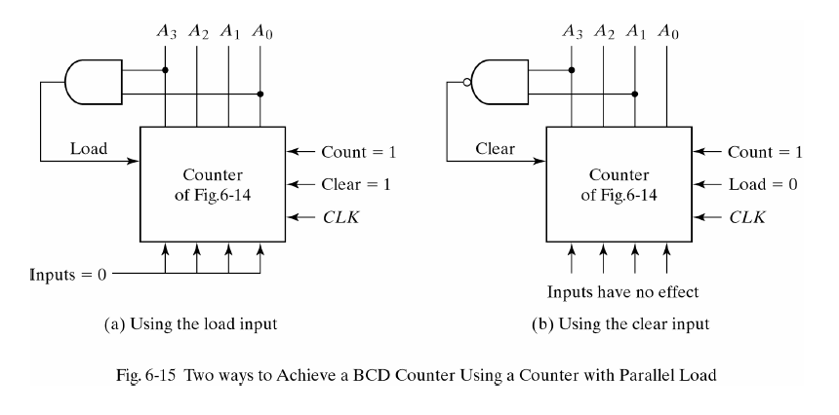
BCD Counter and Modulo N Counter

Slide 11
Counter with Unused States
Often we will have an n-bit counter that does not count through all 2^{n} possible values/ states.
In this case, there will be unused states (unused output patterns).
Strategy - I:
  Treat them as Don’t Care conditions (X)
Caution:
  The circuit may happen to go in any unused state (due to interference or external disturbances)
  A MUST check after the final design is ready
  We need to make sure that unused state → leads (back) to the proper states
  If not, go to Strategy - II

Slide 12
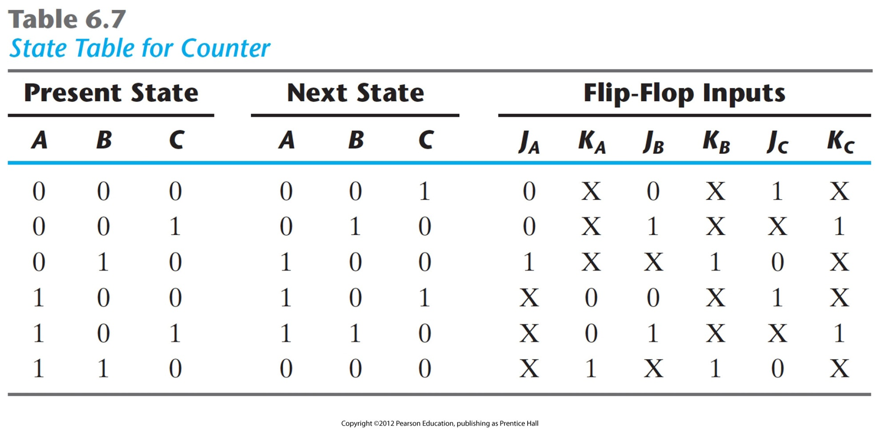
Counter with Unused States
000
001
110
010
101
100
Two Unused States:
011
111

Slide 13
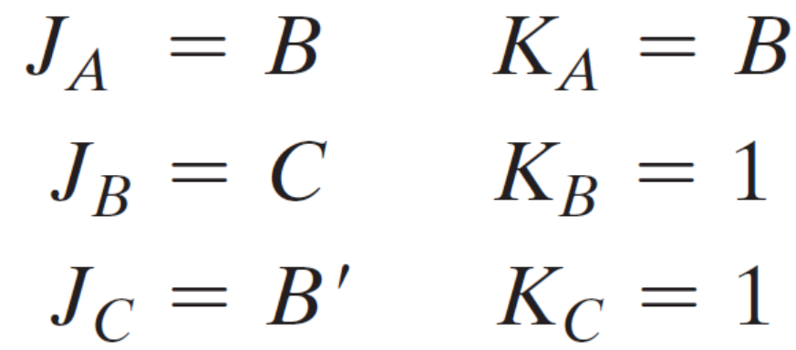
Counter with Unused States
Treat Unused States as ‘X’ while simplifying F/F I/ps in K map

Slide 14
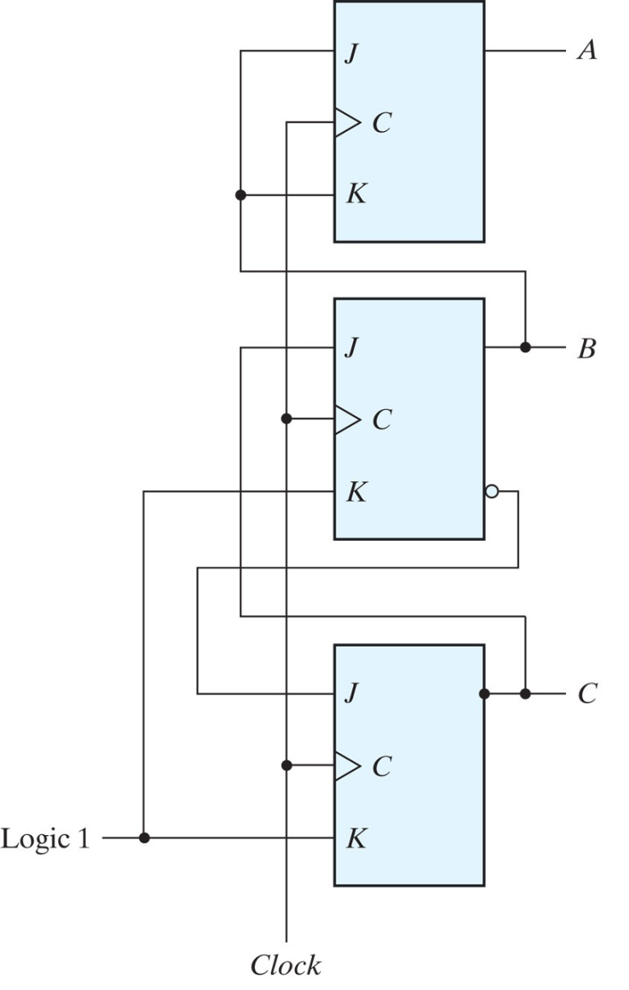

Counter with Unused States
000
001
110
010
101
100
Two Unused States:
011
111

Slide 15

Counter with Unused States

Slide 16
Counter with Unused States (Startegy – II)
Add Unused states in State Table and
Direct them (forcefully) to any used state
0 1 1 ? ? ?
1 1 1 ? ? ?

